Slide 1
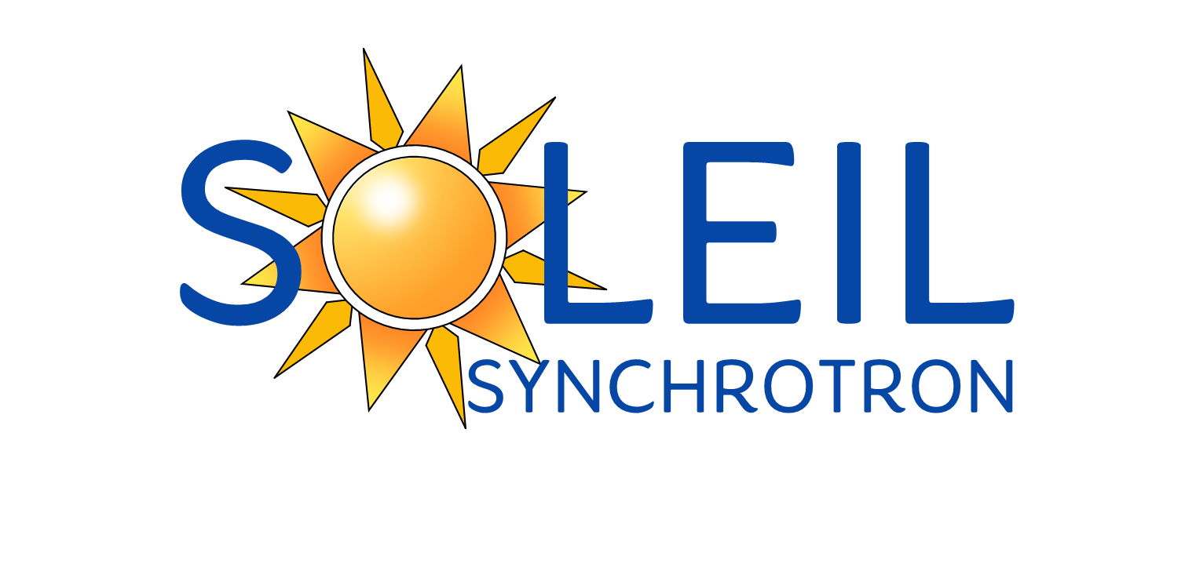
Soft X-ray beamline design and optics consideration
Rafael Celestre
rafael.celestre@synchrotron-soleil.fr
Groupe Optique, Division Expériences, Synchrotron SOLEIL

Slide 2
Soft X-ray beamline design and optics consideration
Outline:
Similar patterns everywhere
Soft x-ray beamline topology
Source
Chicane
Monochromator
Refocusing
Experimental station
Where to learn more?

Slide 3
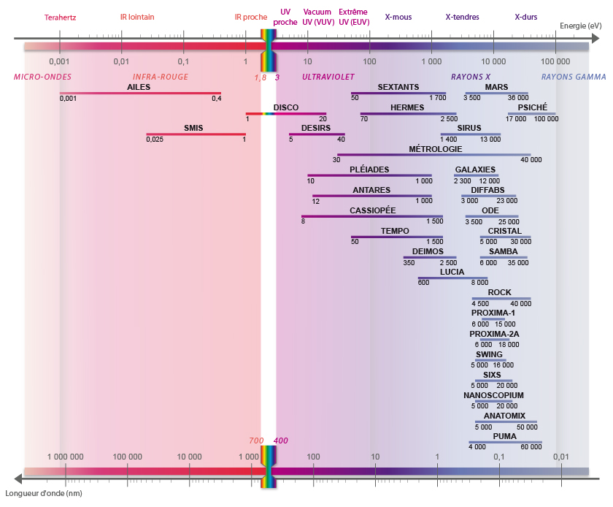
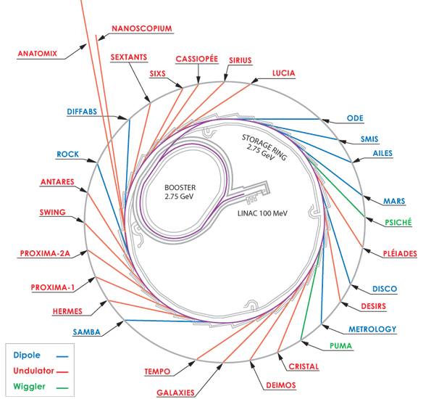
Soft x-ray beamlines: a “heliocentric” view of optical design
SOLEIL beamlines, their energy ranges together with their position along the storage ring. This talk is based on gathered experience from SOLEIL and SOLEIL-II optical design.

Slide 4
Soft x-ray beamlines: similar patterns everywhere
Same patterns are found within low- and mid- energy storage rings (the usual suspects:$ℰ$<3 GeV).

Slide 5
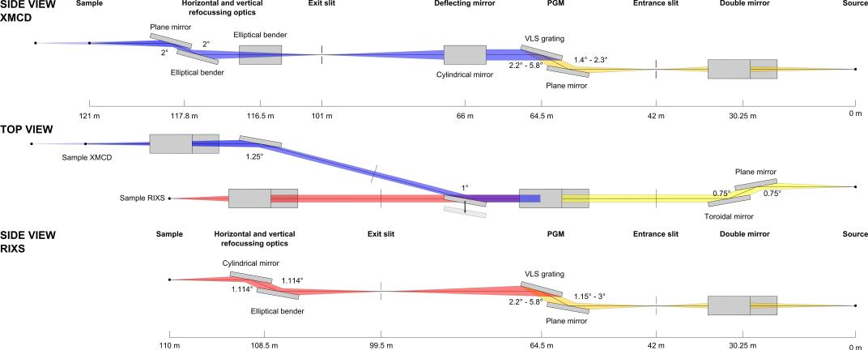
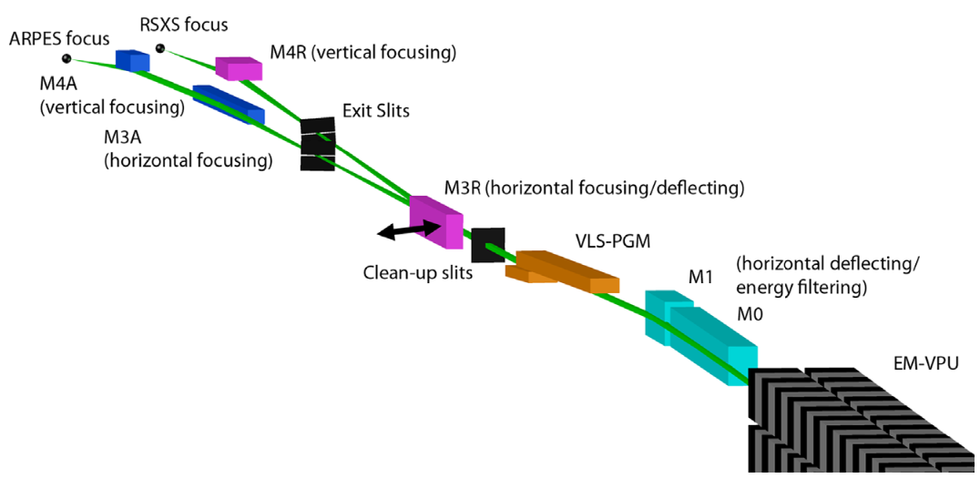


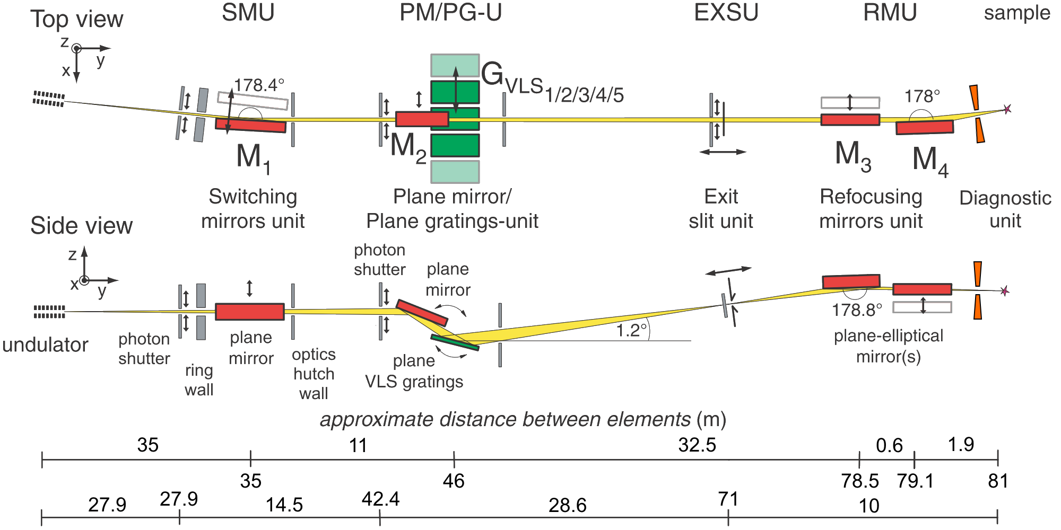
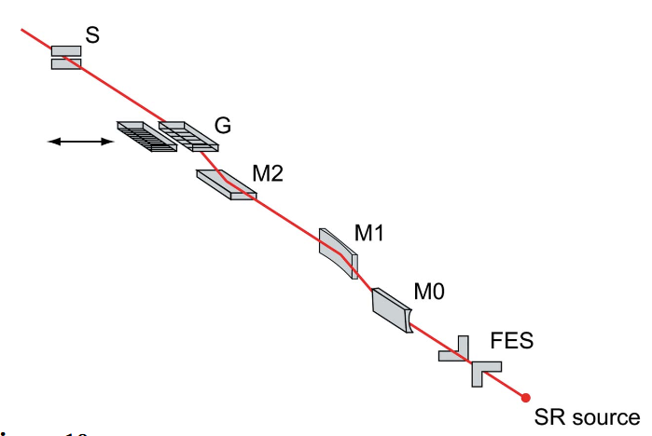
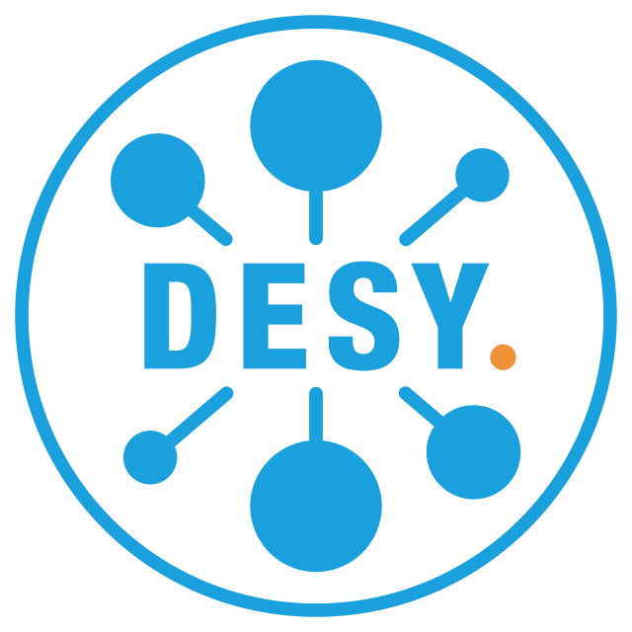

Soft x-ray beamlines: similar patterns everywhere
But also at high energy facilities ($ℰ$>3 GeV):
ID32 – Brookes et al, NIMA 903, 175–192 (2018)
29ID – McChesney et al, NIMA 746, 98–105 (2014)
BL07LSU – Yamamoto et al, JSR 21, 352–365 (2014)
But also: BL17SU, BL25SU, BL25SU and BL25SU.
P04 – Viefhaus et al, NIMA 710, 151–154 (2013)
Notes:
PS: none foreseen for HEPS

Slide 6
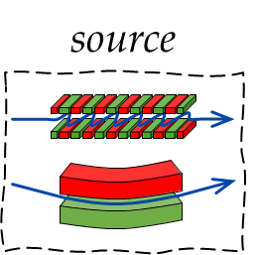
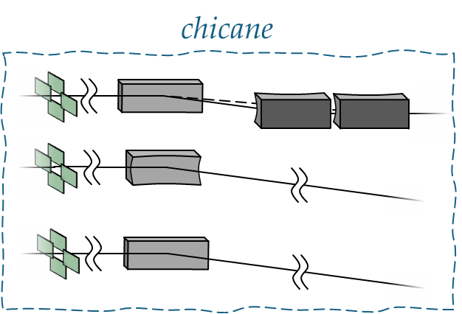
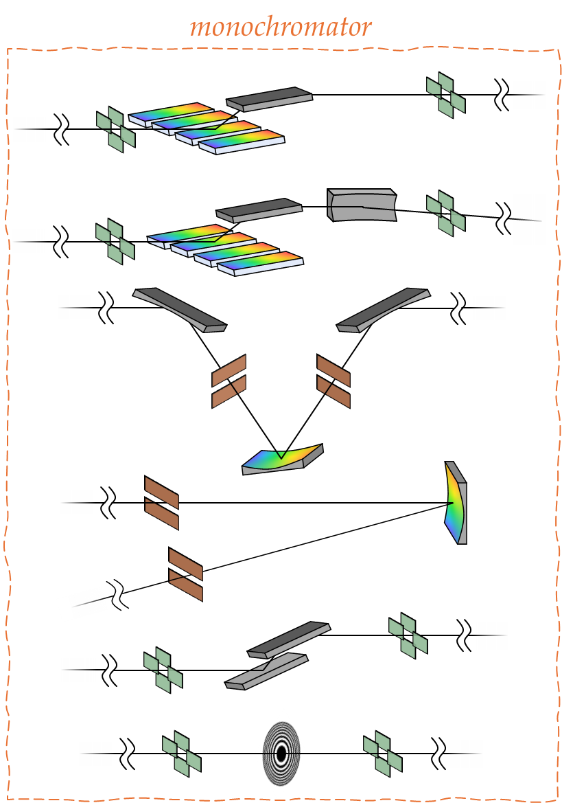
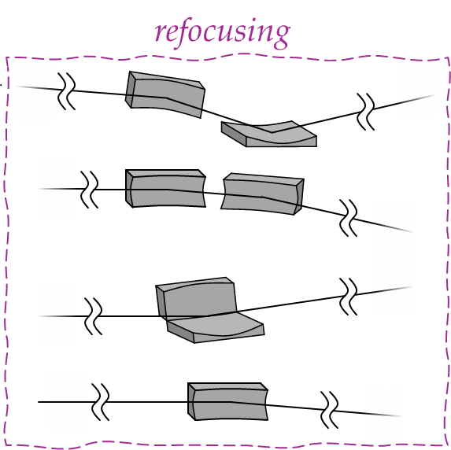
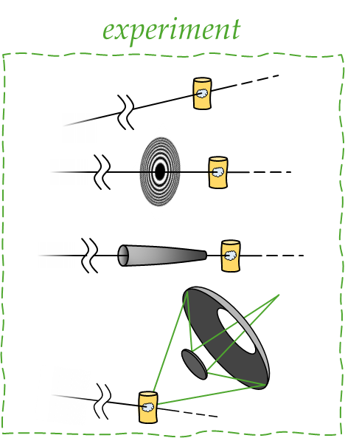
Soft x-ray beamline topology
topology of a generic soft x-ray beamline. The beamline is responsible for photon transport from source to the experimental station. It shapes (collimates, focuses…) the beam and selects an energy (band) for the experiment.

Slide 7
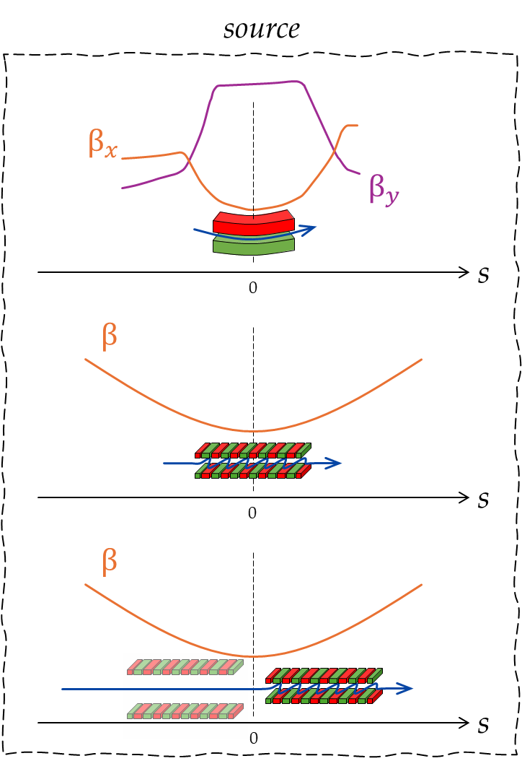
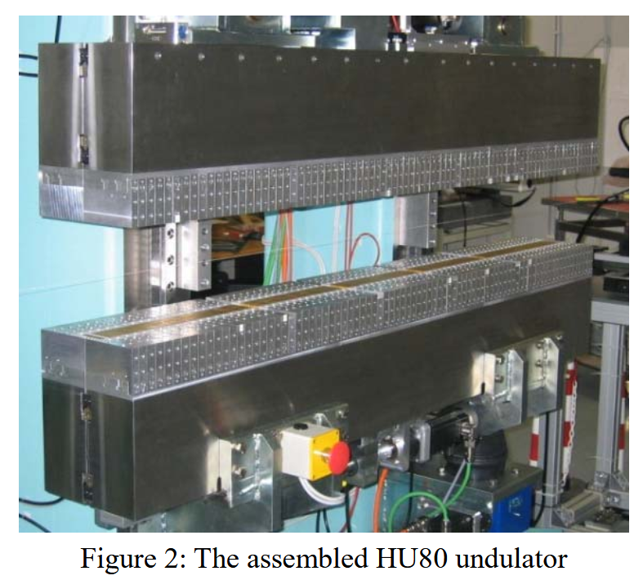
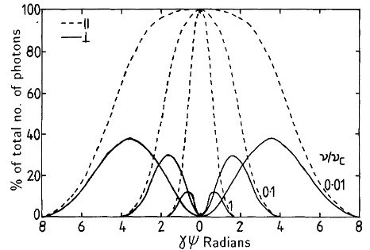
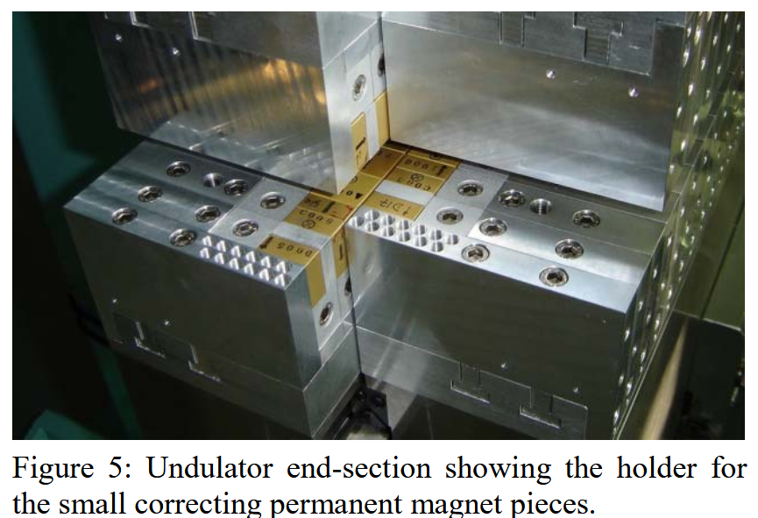
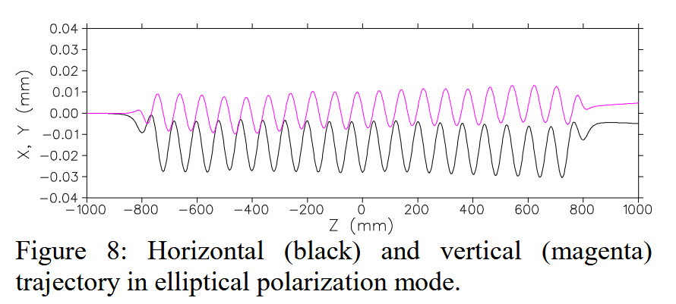
Soft x-ray beamline: the source
Often associated with SXR sources is the necessity of polarisation tunability/control and purity over a wide energy range.
Diviacco et al, Proc. PAC (2005)
reproduction from Fig. 1.7 from “Optical systems for soft x-rays” by A. Michette (1986) representing the angular distribution of the polarised components of BM emission.

Slide 8
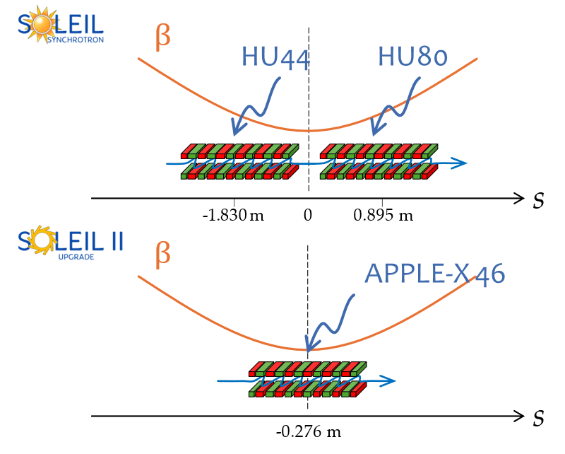
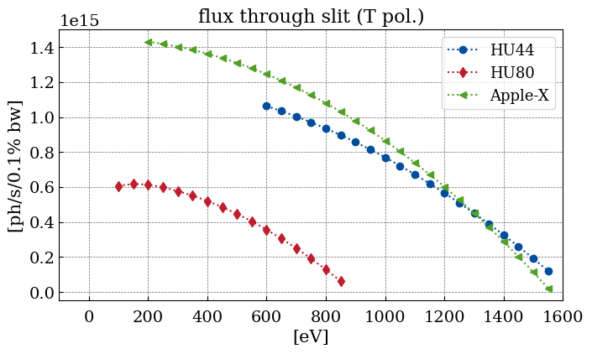
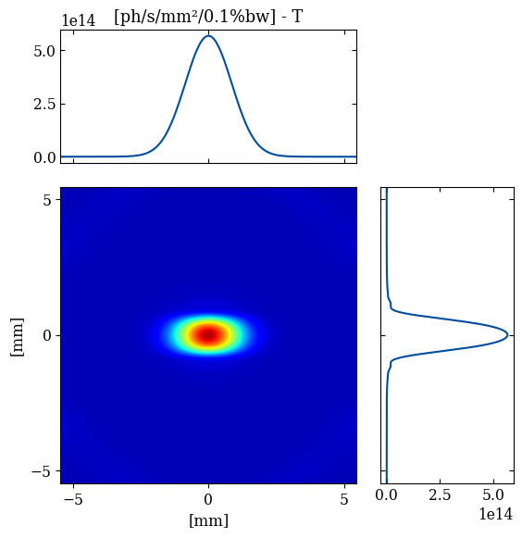
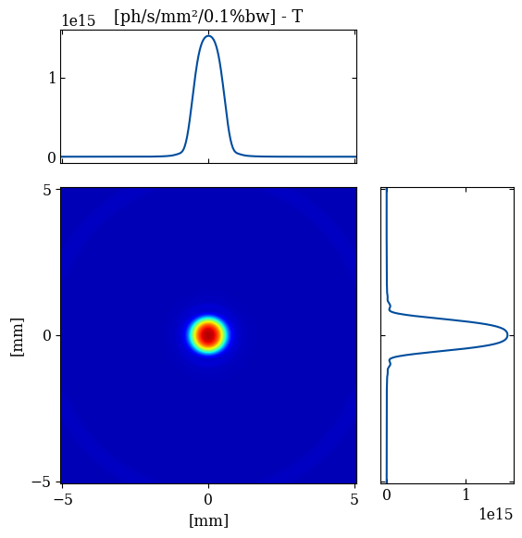
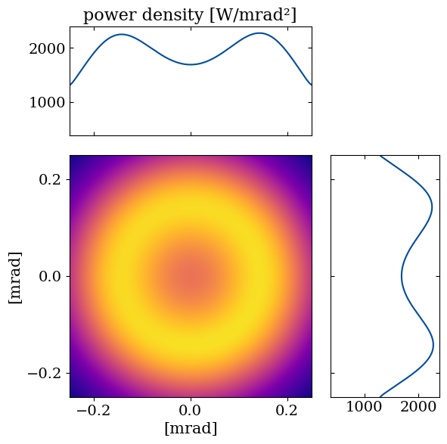
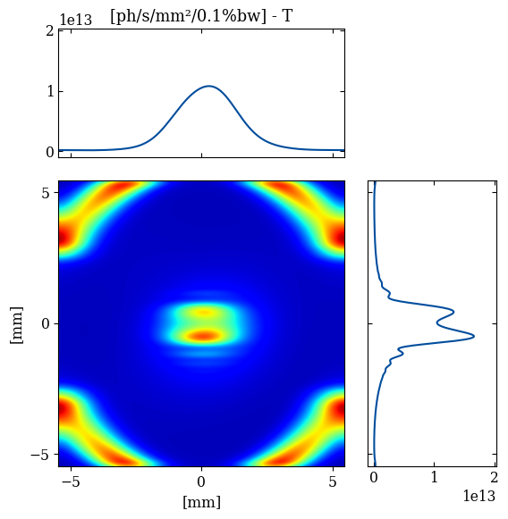
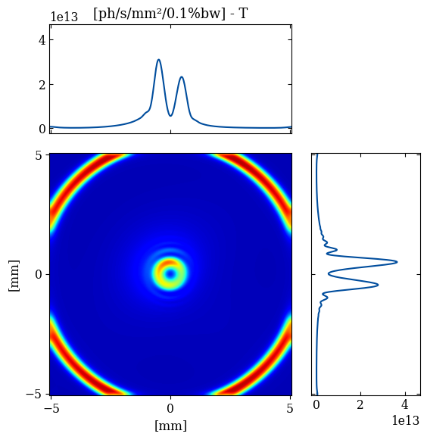
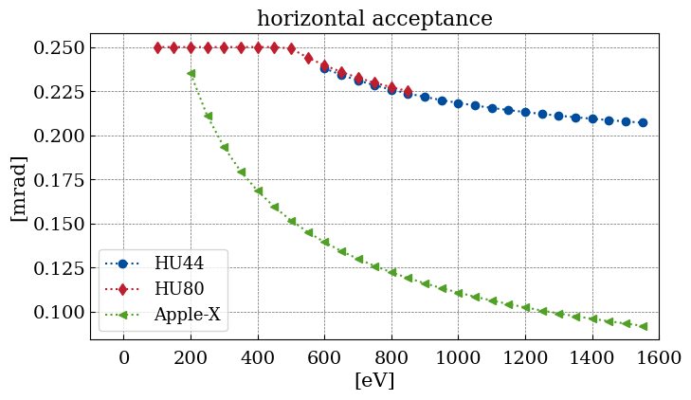
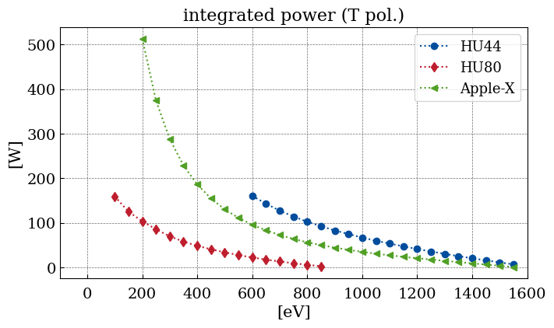
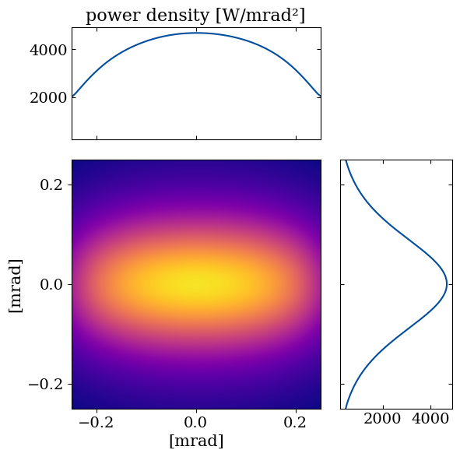
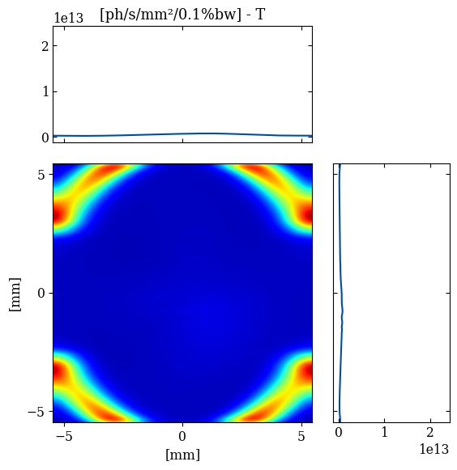
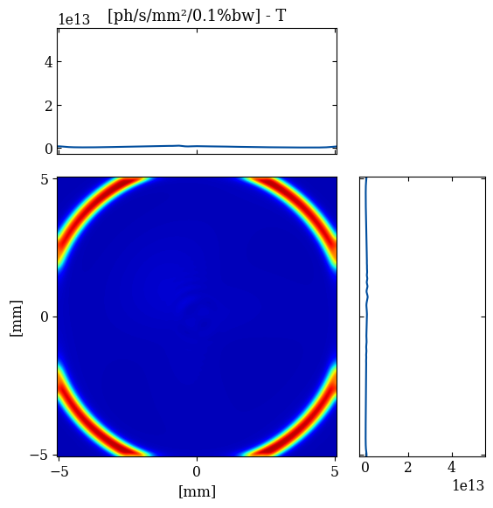
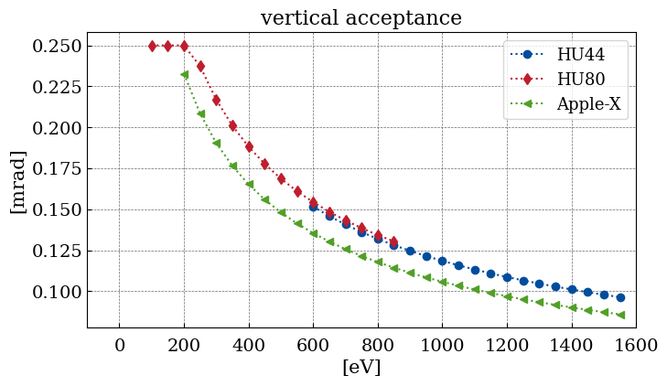
Soft x-ray beamline: the source
Accurate source modelling: flux and power and coherent fraction.
1st
E=720 eV
CL
2nd
LH
3rd
E=720 eV
HU44
Apple-X

Slide 9
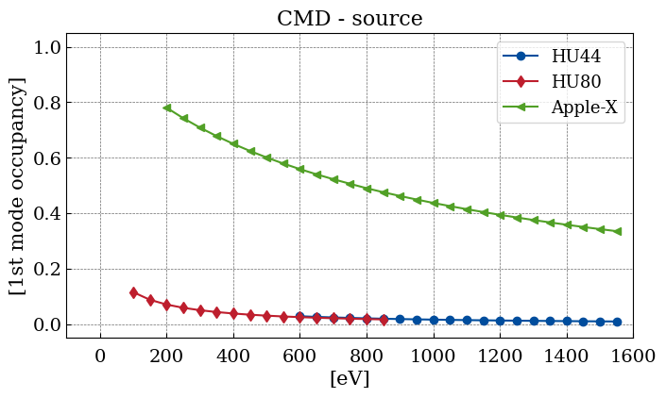
Soft x-ray beamline: the source
Accurate source modelling: flux and power and coherent fraction.
Increased coherent fraction means that diffraction effects may not be neglected! Choosing an appropriate optical theory is important.
Talk: Methods for beamline simulations (Ray tracing/Wave optics/HYBRID)
by Rebuffi and Shi

Slide 10
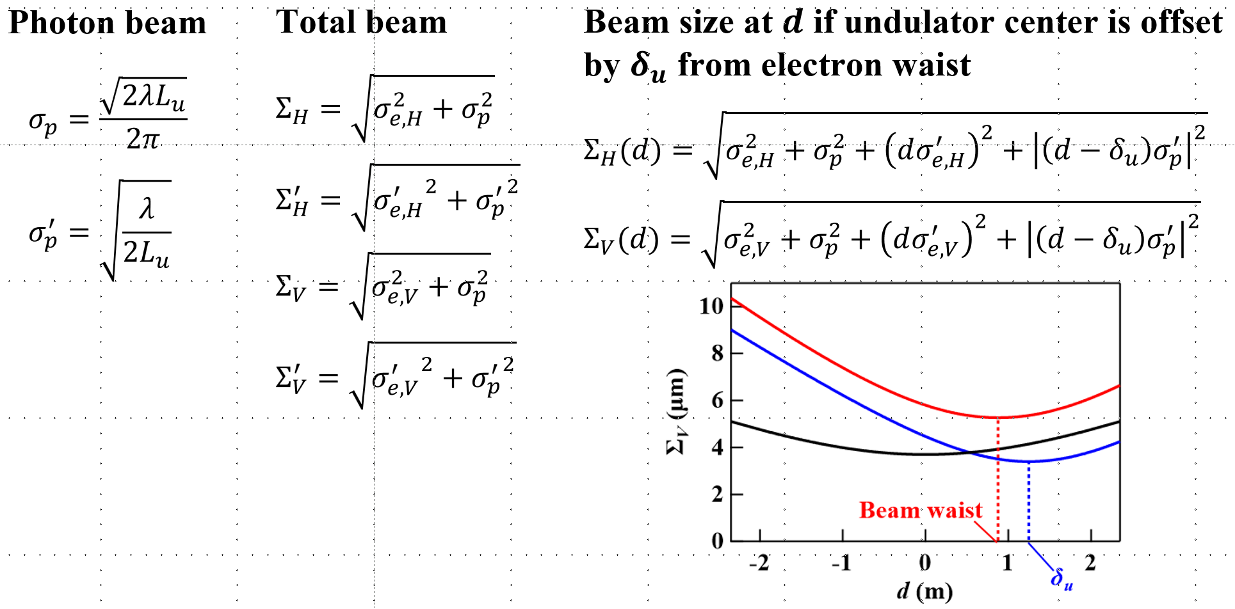
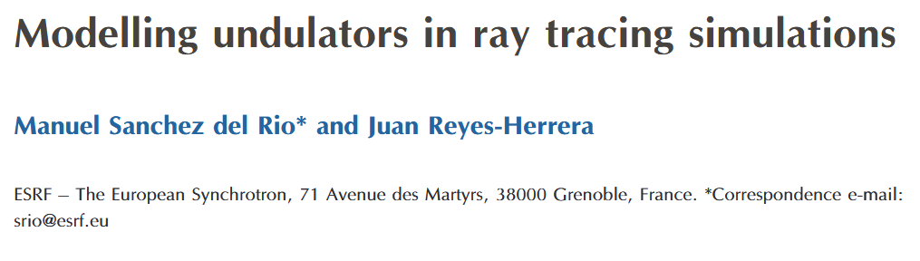
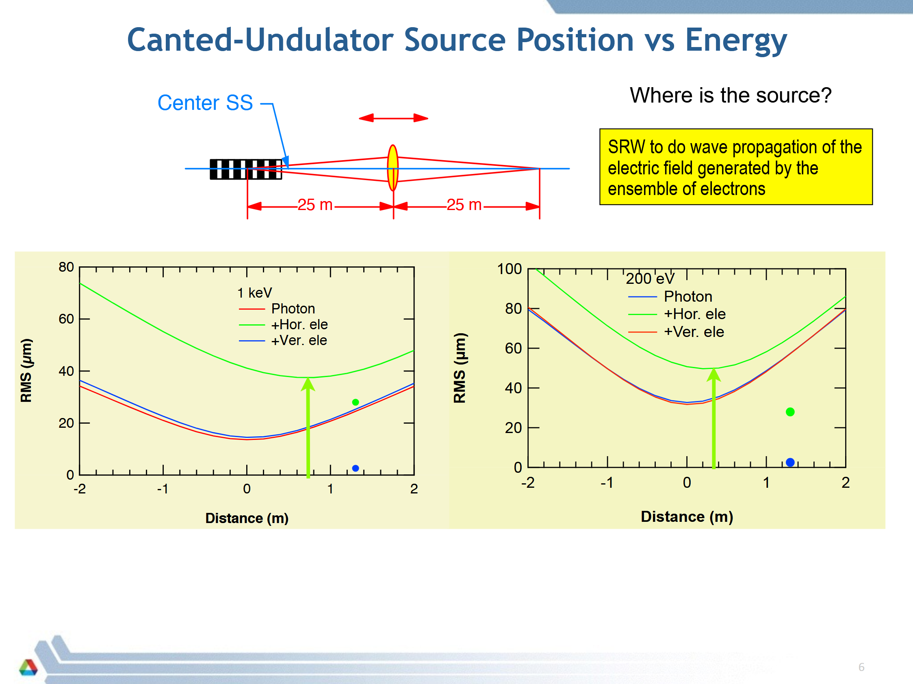
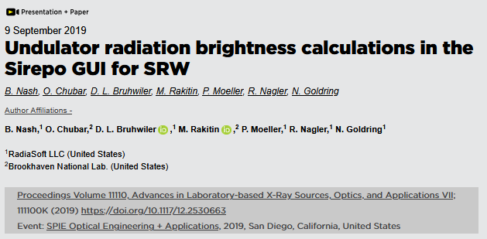
Soft x-ray beamline: the source
Accurate source modelling: position, shape, size and divergence.
(top): reproduction from Shi et al, Proc SPIE 10388C (2017).
(bottom): slide taken from Reininger “X-Ray optics simulations and current developments on software packages – II” SyncLight 2015 (2015).
selected publications (and references therein) dealing with accurate photon beam shape, size and divergence from a finite-emittance electron beam considering energy spread effects.

Slide 11
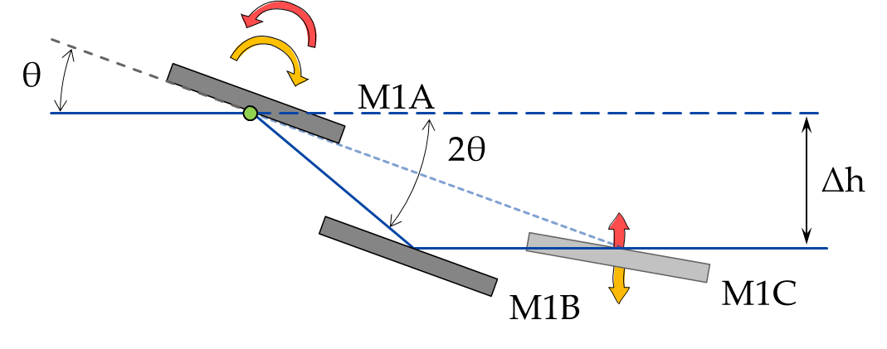
Soft x-ray beamline: the chicane
The functions of the chicane are manifold:
Radioprotection: the first mirror cuts the line of sight between the accelerator and the rest of the beamline. Associated with it, is a high Z material for blocking (very high) energy photons;
a second mirror (pair) can be used for making the outgoing beam parallel to the incoming beam.
sketch of a typical M1 chicane used at SOLEIL

Slide 12
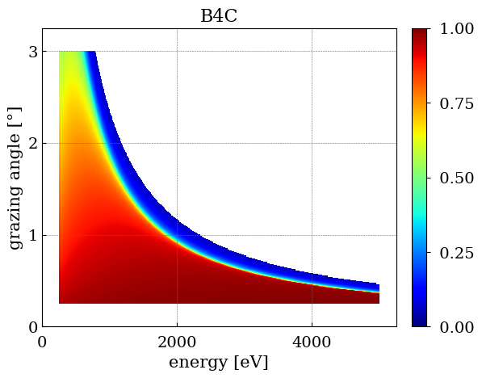
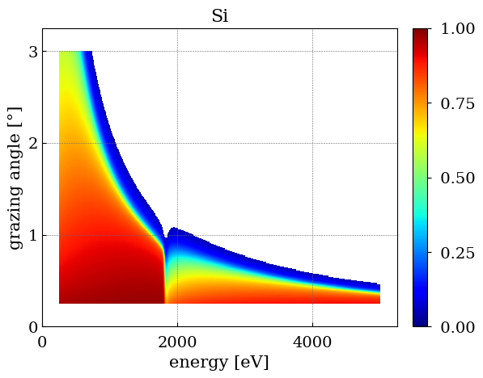
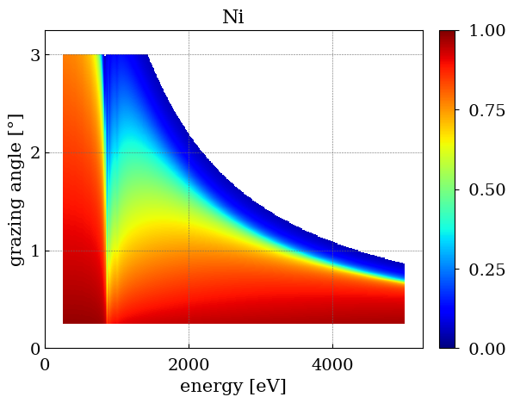
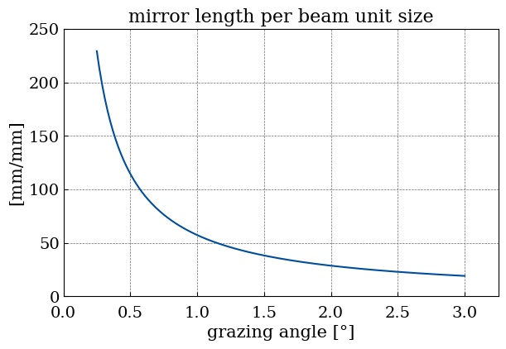
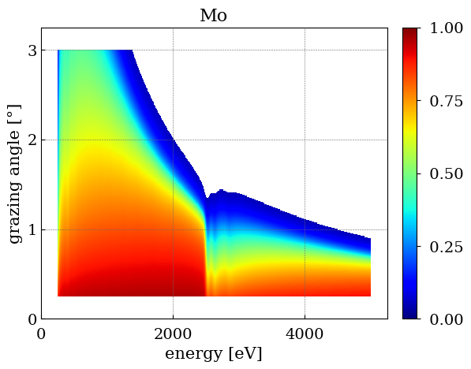
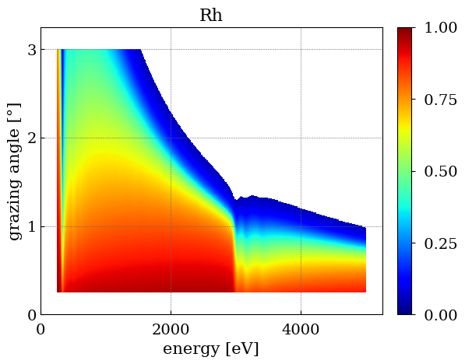
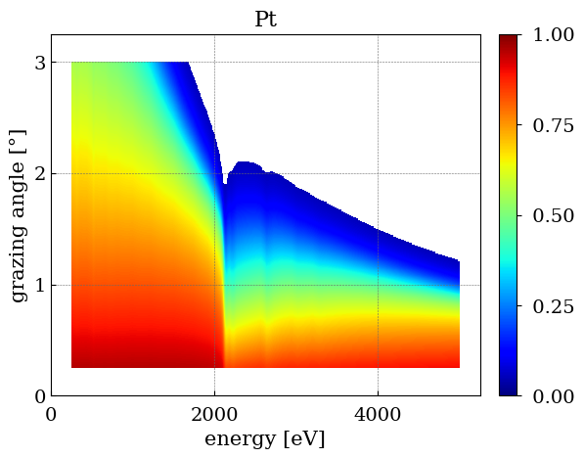
Soft x-ray beamline: the chicane
The functions of the chicane are manifold:
Energy filtrering: mirrors (and their coatings) act as a low pass filter (true for all BL mirrors).
reflectivity for commonly used materials in x-ray mirrors. The M1 system is compromise between grazing angle/total mirror length and overall transmission for the specified energy range.

Slide 13
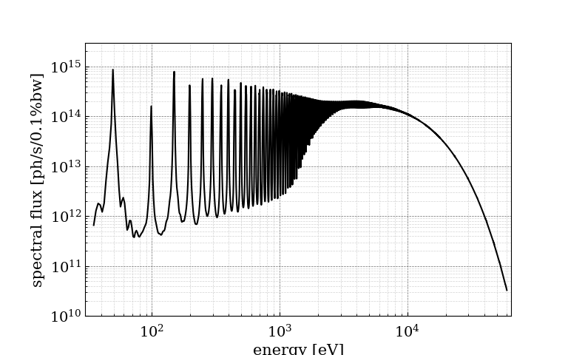
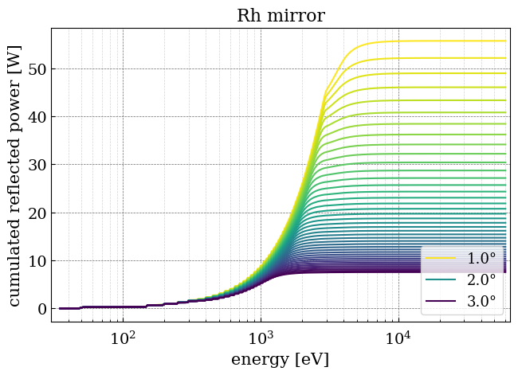
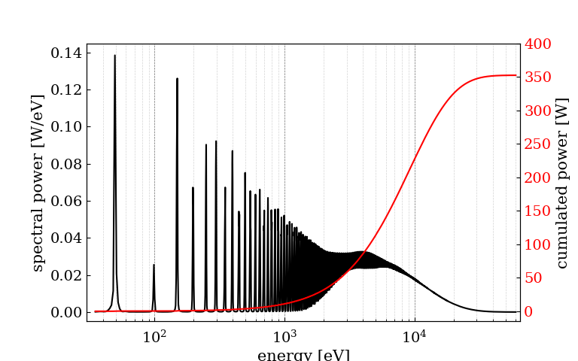
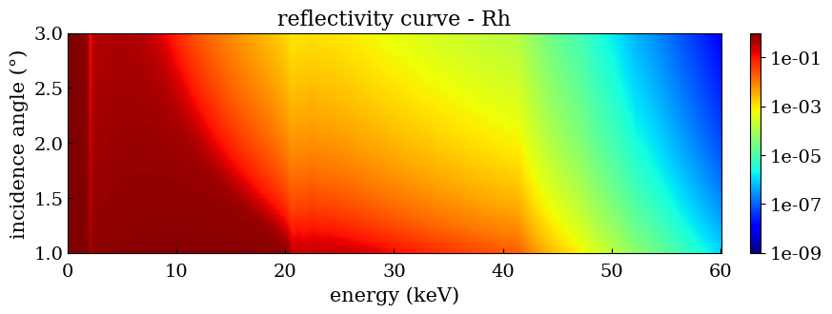
Soft x-ray beamline: the chicane
The functions of the chicane are manifold:
Power absorption: the high energy content filtered out by the M1 is absorbed by it.
Talk: Power transport calculation, SRCalc, XOPPY by Sanchez del Rio
Talk: Thermal load calculation through beamline by Rebuffi
HU64 (K=6.5487, N=28)
0.2 x 0.2 mrad
energy [eV]

Slide 14
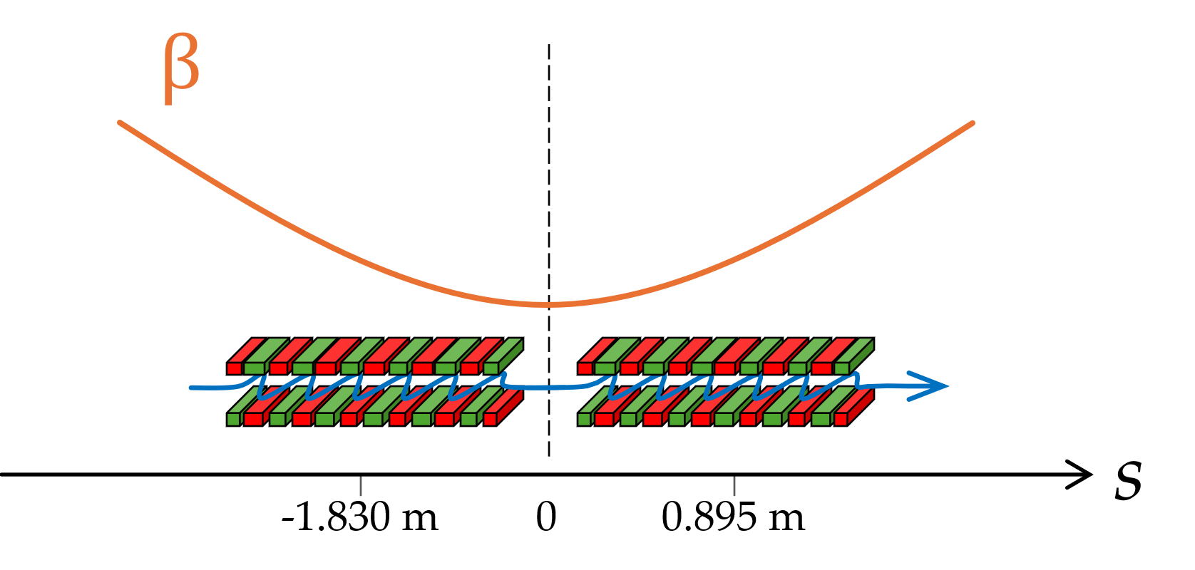
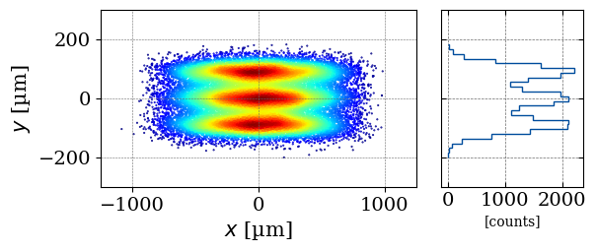




Soft x-ray beamline: the chicane
The functions of the chicane are manifold:
Condensation or collimation: if curved mirrors used to condition the beam prior to the monochromator, they impact the beamline energy resolution.
HU60
HU256
$$E_{0}=101eV$$
(E/∆E = 20k)
effect moving 0.895 m upstream the HU256 on the energy resolution of the G600l/mm grating monochromator.
source and truncated beamline (Antares)

Slide 15




Soft x-ray beamline: the monochromator
Monochromators in SXR beamlines are usually built with gratings (in normal or grazing incidence) for the lower energies, multilayer gratings or high-d spacing crystals for the higher energies.
Grating-based systems are more preponderant for SXR beamlines:
energy selection is done by spatially filtering polychromatic SR with an exit slit where the beam is focused onto
always compromise between flux and energy resolution (slit size)
$$mλ=D_{0}\left(\sin{α+\sin{β}}\right)$$
$$\frac{Δλ}{λ}=\frac{ΔE}{E}=\frac{s\cos{β}}{λmD_{0}r′}$$
Reininger, “Monochromators and associated optical equipment”, CAS: SR and FELs 1990.
Grating cartoon taken from
Edmund Optics website

Slide 16
Soft x-ray beamline: the monochromator
Special topic: Grating monochromators
Talk: Grating design by Sanchez del Rio
Talk: Grating simulations by Sanchez del Rio
You can learn more about grating & monochromators here:
Reininger, "Monochromators and associated optical equipment," CERN Accelerator School : Synchrotron Radiation and Free-electron Lasers, pp.401-426 (1990).
Hulbert, "Grating-based monochromators," International Tables for Crystallography 302–314 (2022).
Koike, "1. Normal-Incidence Monochromators and Spectrometers," Experimental Methods in the Physical Sciences 1–20 (1998).
Padmore, Howells, and McKinney, "2. Grazing-Incidence Monochromators for Third-Generation Synchrotron Radiation Sources," Experimental Methods in the Physical Sciences 21–54 (1998).
Underwood, "3. Spectrographs and Monochromators Using Varied Line Spacing Gratings," Experimental Methods in the Physical Sciences 55–72 (1998).
Thorne and Howells, "4. Interferometric Spectrometers," Experimental Methods in the Physical Sciences 73–106 (1998).

Slide 17




Soft x-ray beamline: refocusing
This part of the beamline is responsible for focusing the beam leaving the monochromator into the sample or to a secondary source for further demagnification downstream in the experimental station.
mirrors reflect efficiently for grazing angles smaller than $θ_{c}<\sqrt{2δ}$
paraxial design is done using the Coddington equations
typical shapes used for x-ray mirrors: plane (no focusing), toroidal (focusing in both sagittal and meridional directions); spherical, parabolic, ellipsoidal and hyperbolic shape than can come in cylindrical variations.
spherical and coma aberrations are present!
$$f_{m}=\frac{R_{m}⋅sin\left( θ\right)}{2}$$
$$f_{s}=\frac{R_{s}}{2sin\left(θ\right)}$$

Slide 18




Soft x-ray beamline: refocusing
Commonly used crossed two mirror systems:
Kirkpatrick-Baez (KB)
Hildenbrand-Montel (or confocal KB)
These systems do not obey the Abbe sine condition, and the focused beam will present coma aberration for large angular collection.
Commonly used coaxial two mirror systems:
Wolter (types I, II, III)
Wolter-Schwarzchild
Namioka-Conjugate Spheres
These systems obey the Abbe sine condition!
reproduction from “Optical systems for soft x-rays” by A. Michette (1986)
reproduction from “Gratings, mirrors and slits” by W. Peatman (1997)

Slide 19
Soft x-ray beamline: optics in the experimental station
The optics in the experimental hutch are not often included in the beamline design and are subjected to a separate calculation. Their choice is directly related to the experimental technique:
x-ray focusing (or condensing) into the sample;
collection of x-rays from the sample;
as both a condenser and objective lenses.

Slide 20



Soft x-ray beamline: optics in the experimental station
The optics in the experimental hutch are not often included in the beamline design and are subjected to a separate calculation. Their choice is directly related to the experimental technique:
Fresnel zone plates (diffractive)
reproduction from “x-ray-optics.de” by Last (2025) based on Jefimovs et al, J Synchrotron Rad 15(1), 106–108 (2007).
reproduction from Chao et al, Nature 435(7046), 1210–1213 (2005).
Baez, J. Opt. Soc. Am. 51(4), 405 (1961)

Slide 21



Soft x-ray beamline: optics in the experimental station
The optics in the experimental hutch are not often included in the beamline design and are subjected to a separate calculation. Their choice is directly related to the experimental technique:
(mono/poli) capillary optics (reflective)
Yanagihara et al, "X‐Ray Optics," X‐Ray Spectrometry: Recent Technological Advances 63–131 (2004).
Balaic et al, J Synchrotron Rad 2(6), 296–299 (1995).

Slide 22


Soft x-ray beamline: optics in the experimental station
The optics in the experimental hutch are not often included in the beamline design and are subjected to a separate calculation. Their choice is directly related to the experimental technique:
Schwarzschild/Cassegrain (reflective)
Capasso et al, Surface Science 287–288, 1046–1050 (1993).
Horikawa et al, Journal of Microscopy 172(3), 189–194 (1993).

Slide 23










Where to learn more?
http://www.x-ray-optics.de

Slide 24
Thank you!

